Slide 1
English Stylistics
Week 12 Syntactic features II

Slide 2
In today’s class
Foregrounding in stylistics
Syntactic deviation (periodic vs. loose sentences)
Measurement of text readability

Slide 3
Stylistic features
“We recognize a style only when certain choices of language features recur or prevail in a text” (Qian, p.19)
Frequency, repetition, and parallelism
→ A quantitative pattern

Slide 4
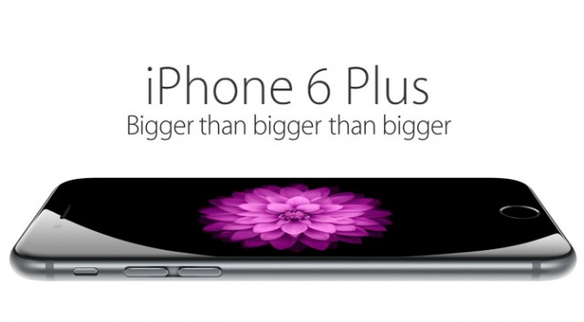

But rare exceptions are also significant …
“A Grief Ago” (Dylan Thomas)

Slide 5
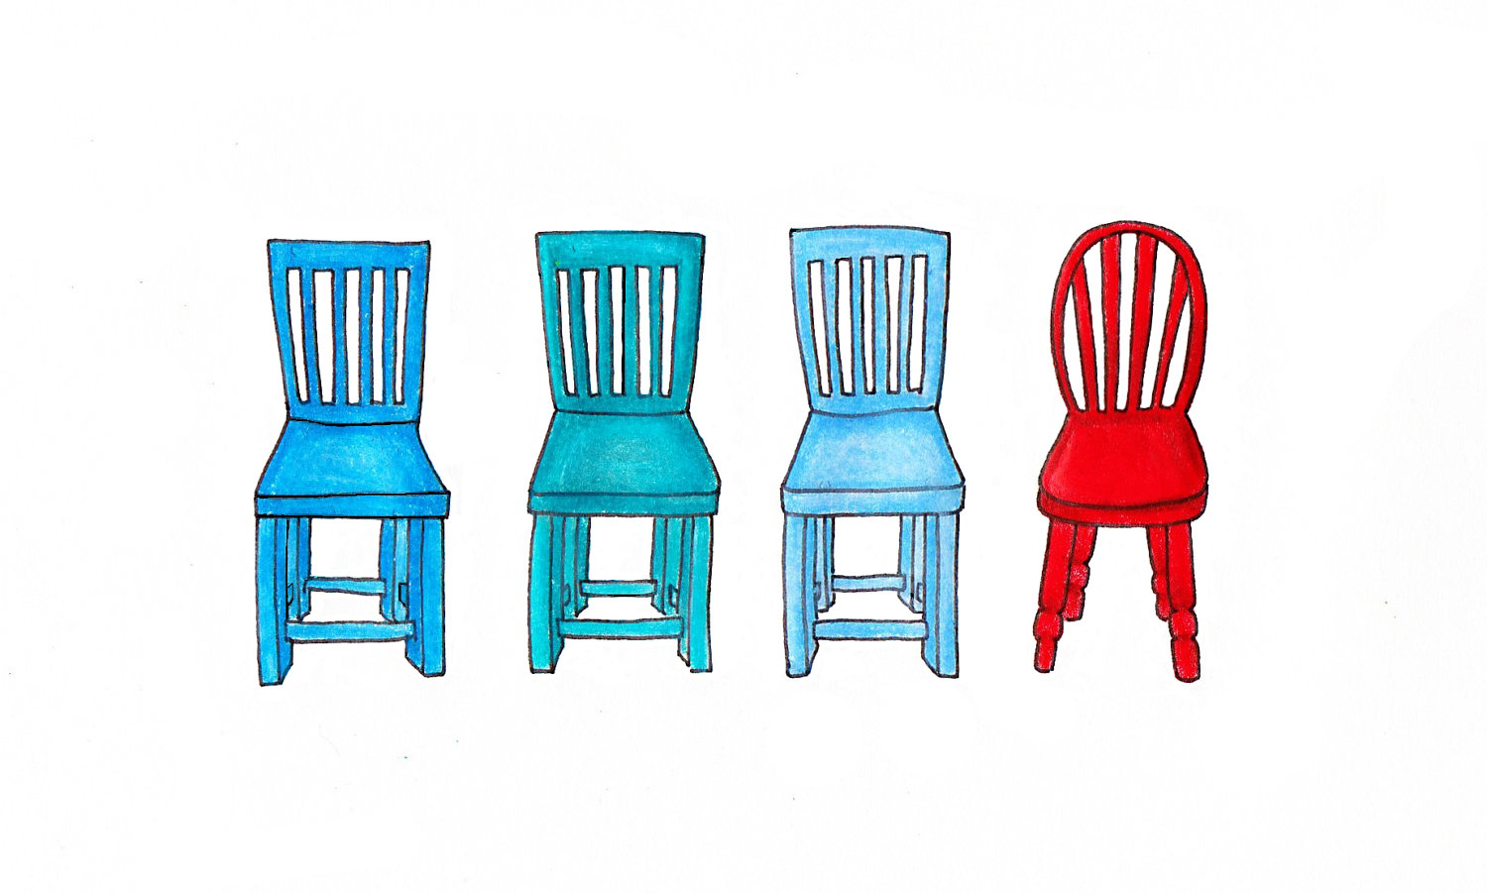
Norms and deviations in stylistics
Norm – the regular pattern, the convention
Deviation – violation of the convention, the odd one

Slide 6

Foregrounding 前景化
The function of art – a new perspective, to de-familiarize the familiar (background) 陌生化
Foregrounding as a means of defamiliarization
→ deviation (the odd) and parallelism (the repetitive)

Slide 7
Syntactic features: the regular patterns
Sentences of different lengths
Sentences of different structures
Sentences of different voices
Sentences of different functions

Slide 8
Syntactic features: Deviations & Irregularity
Elliptical sentences and Inverted sentences
Rhetorical questions (Text 27)
Loose sentences vs. periodic sentences
Non-standard forms (esp. regional or social dialect)

Slide 9
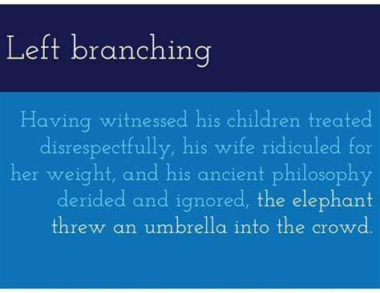
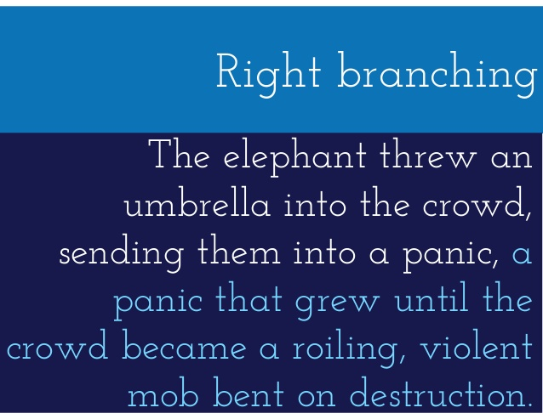
Sentence branching

Slide 10
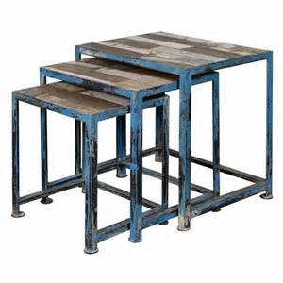
Middle-branching (nesting)
Love, as everyone knows except those who happened to have been afflicted with it, is blind.

Slide 11
Branching and style
Right-branching (LOOSE structure)
→ supplementary, easy, natural
Left-branching and nesting (PERIODIC structure)
→ anticipatory, suspension-making
→ evasive and sophisticated

Slide 12
A familiar example
Having considered both sides of the argument, I have come to the conclusion that the advantages of owning a car outweigh the disadvantages.

Slide 13

A proper example
It is a truth universally acknowledged that a single man in possession of a fortune must be in want of a wife.

Slide 14

Reading: Text 28

Slide 15

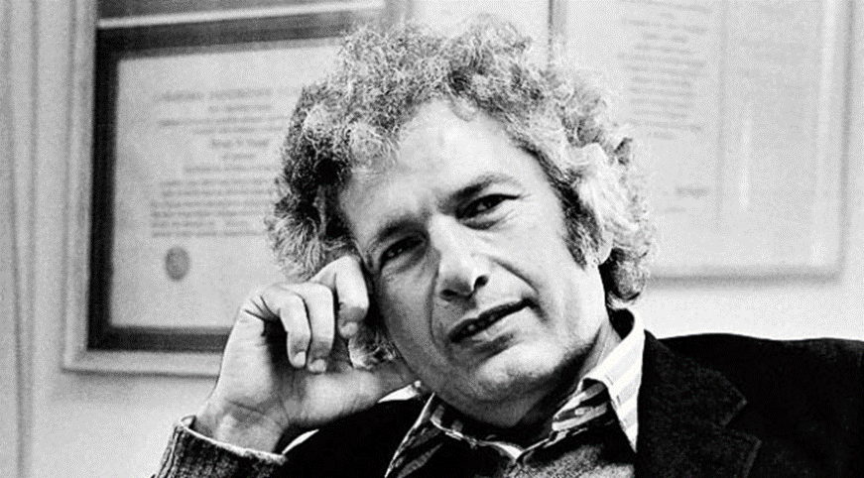
Reading: Text 29
Joseph Heller (1923-1999)

Slide 16
A “Catch” – logical paradox
Yossarian looked at him soberly and tried another approach. "Is Orr crazy?"
"He sure is," Doc Daneeka said.
"Can you ground him?"
"I sure can. But first he has to ask me to. That's part of the rule."
"Then why doesn't he ask you to?“

Slide 17
"Because he's crazy," Doc Daneeka said. "He has to be crazy to keep flying combat missions after all the close calls he's had. Sure, I can ground Orr. But first he has to ask me to.“
"That's all he has to do to be grounded?"
"That's all. Let him ask me."
"And then you can ground him?" Yossarian asked.
"No. Then I can't ground him.“
"You mean there's a catch?“
"Sure there's a catch," Doc Daneeka replied. "Catch-22. Anyone who wants to get out of combat duty isn't really crazy."

Slide 18
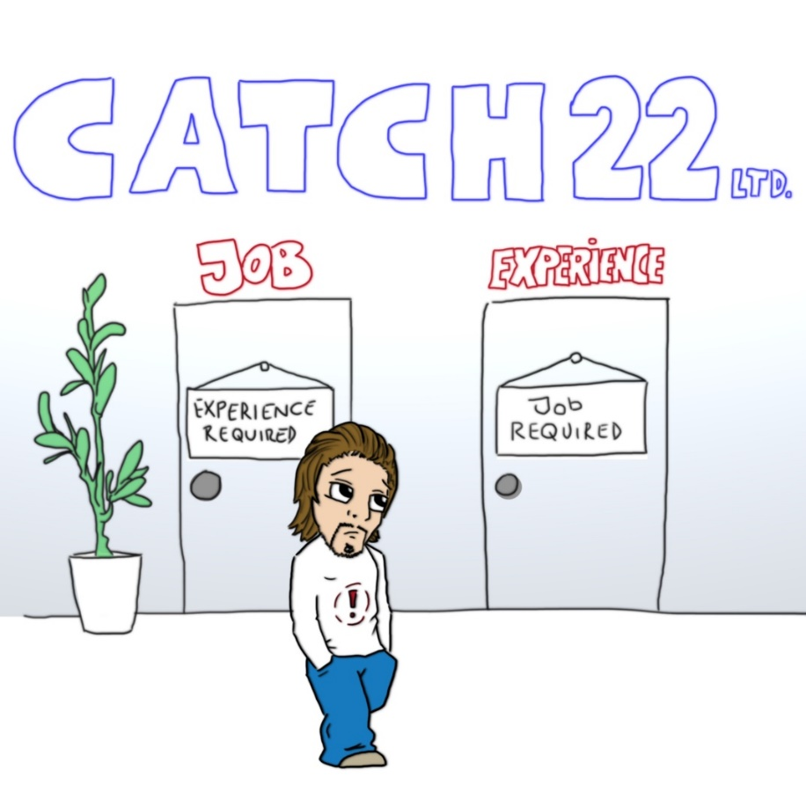
Catch-22
a paradoxical situation from which an individual cannot escape because of contradictory rules or limitations

Slide 20
Text readability
Readability is the ease with which a reader can understand a written text.
In natural language, the readability of text depends on its content (the complexity of its vocabulary and syntax) and its presentation (such as typographic aspects like font size, line height, and line length).

Slide 21
Text readability
The Flesch formula
The Gunning fog index
The Lexile Index

Slide 22
DONALD TRUMP TALKS LIKE A 4TH GRADER: REPORT （Newsweek, 20150814）
Republican presidential front runner Donald Trump talks like a 4th grader, according to a linguistic analysis performed by Politico's Jack Shafer. Shafer ran the text of Trumps' responses in the recent Republican debate through the Flesch-Kincaid test, designed to determine how difficult a given passage is to understand for English readers.

Slide 23
The Flesch formulas (1943, 1951)
Reading ease score = 1.599 nosw − 1.015sl − 31.517
nosw = number of one-syllable words per 100 words
sl = average sentence length in words.

Slide 24
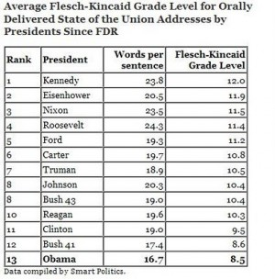
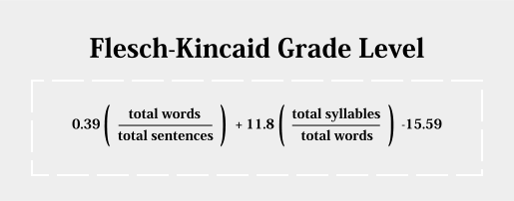

Slide 25
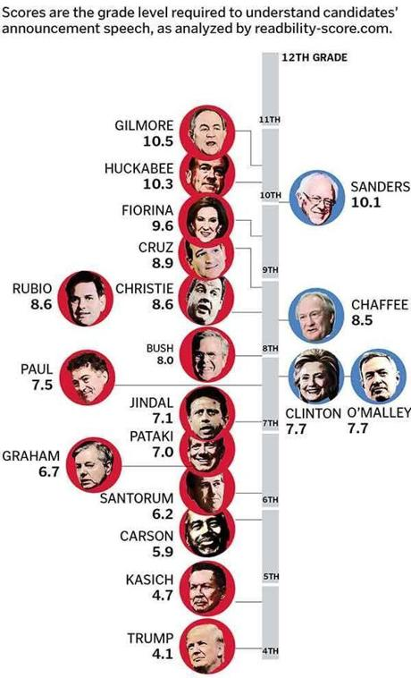
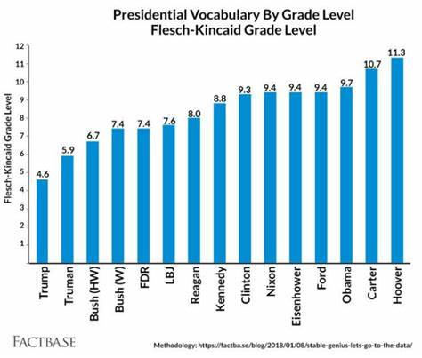

Slide 26
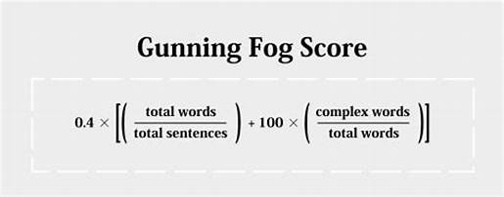
Gunning Fog index (1952)

Slide 27
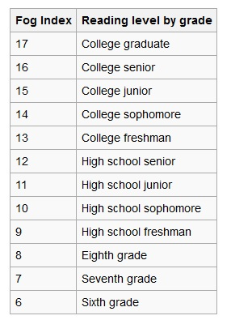
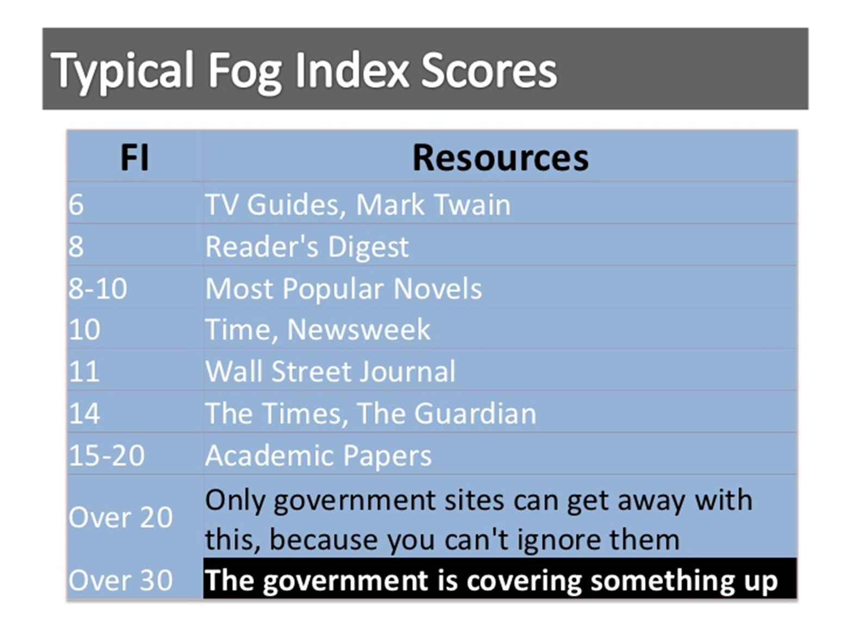

Slide 28
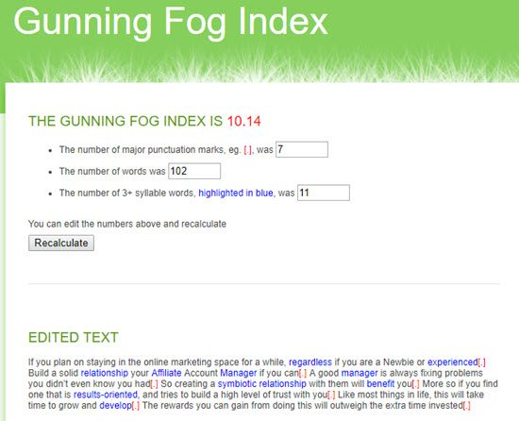
Explore: http://gunning-fog-index.com/

Slide 29
The Lexile Index
The Lexile Analyzer, a software program specially designed to evaluate reading demand, analyzes the text's semantic (word frequency) and syntactic (sentence length) characteristics and assigns it a Lexile measure.

Slide 30
The Lexile Index
Over 60,000 Web sites, 115,000 fiction and nonfiction books, and 80 million articles have Lexile measures, and these numbers continue to grow.
0-2000 (highly technical)

Slide 31
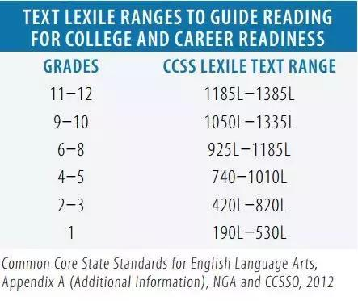

Slide 32
Explore: https://fab.lexile.com/
Find about your own Lexile index
Find a book to suit your Lexile index

Slide 33
Food for thought:
The measurement of the “complexity” of sentences
The balance between readability, formality and variety
The strengths and defects of different readability indexes
The development and application of Chinese readability indexes

